Slide 1
Robotics and Control (2) Project
Mohamed Abdelwahab, Marco Mustacchi, David Pfeifer

Slide 2

Table of Contents:
Problem Definition
Tracking Controller
Performance Measures for Tracking
Regulation Controller
Performance Measures for Regulation
Summary

Slide 3
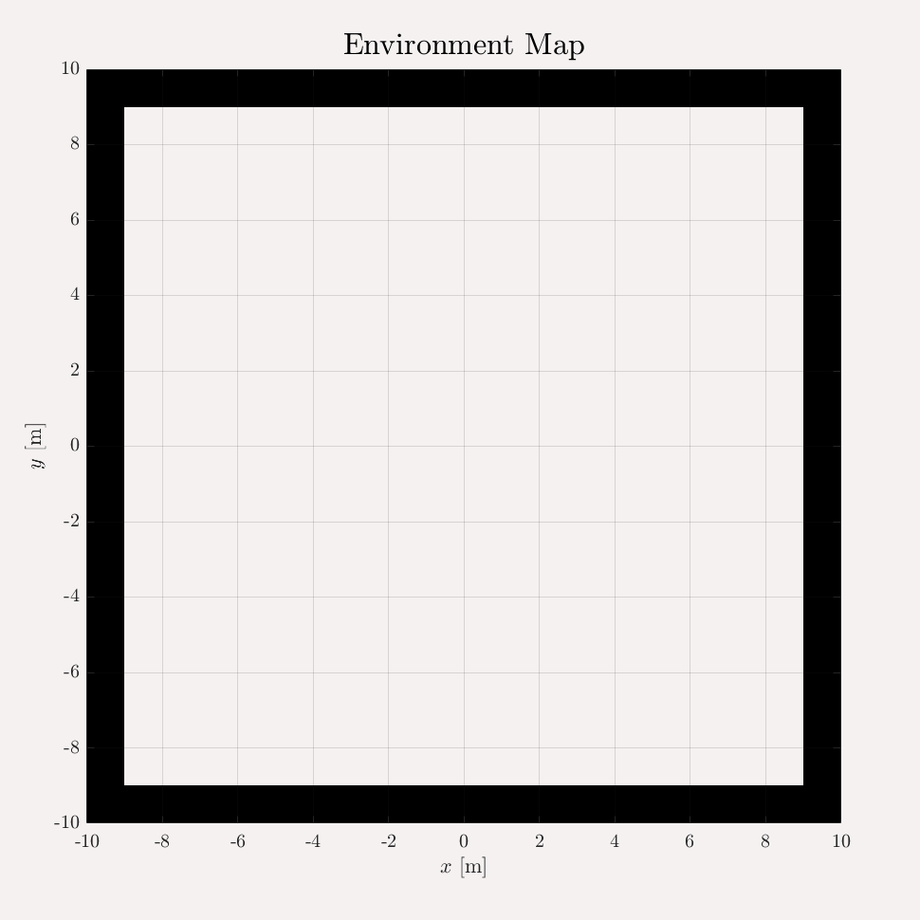
Problem Definition: Environment
Occupancy Grid
To create an environment we used the Matlab Tool: Occupancy Grid.

Slide 4
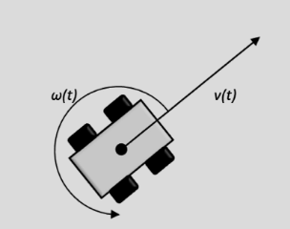
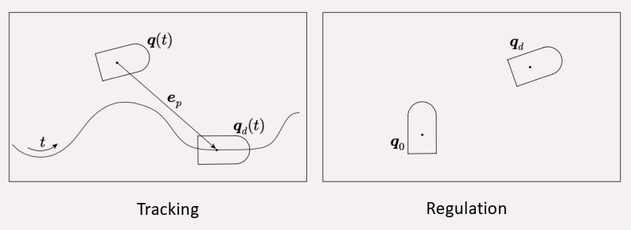
Problem Definition: Overview
Path
Controller
Unicycle
Differential Flat
output
Tracking
- Linear/NonLinear State Feedback
- Output Feedback
Regulation
- Cartesian Regulation
- Posture Regulation

Slide 5
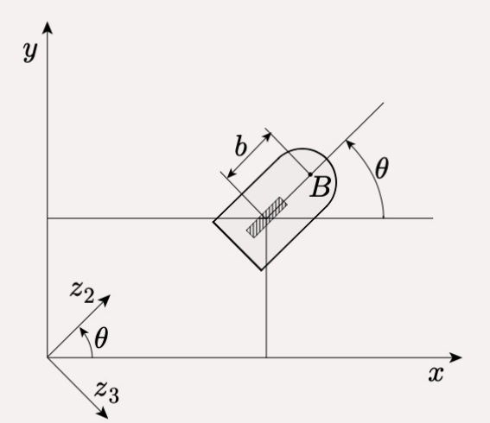
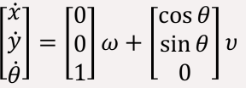
Problem Definition: Unicycle Model
An example is the differential-drive robot
- (𝑥, 𝑦) of the unicycle is the midpoint
of the segment joining the two differential
drive’s fixed wheels
The unicycle’s inputs are
- 𝑣 the heading velocity
- 𝜔 the steering velocity
The unicycle’s model

Slide 6
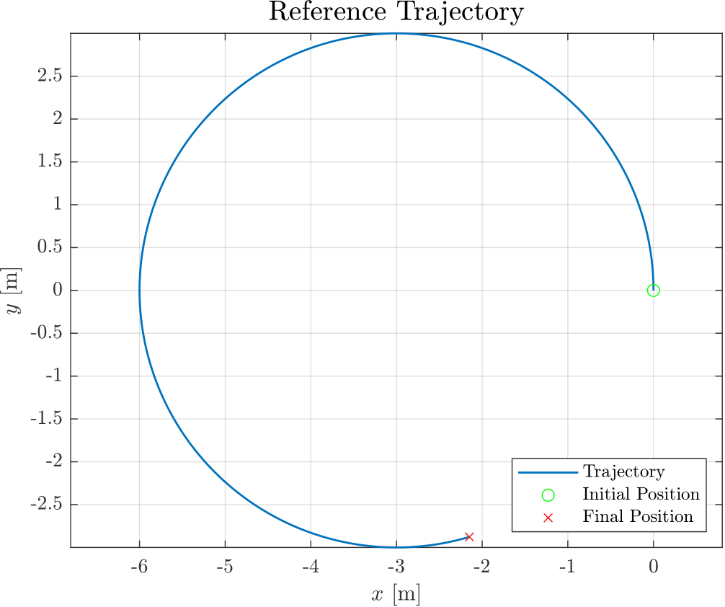
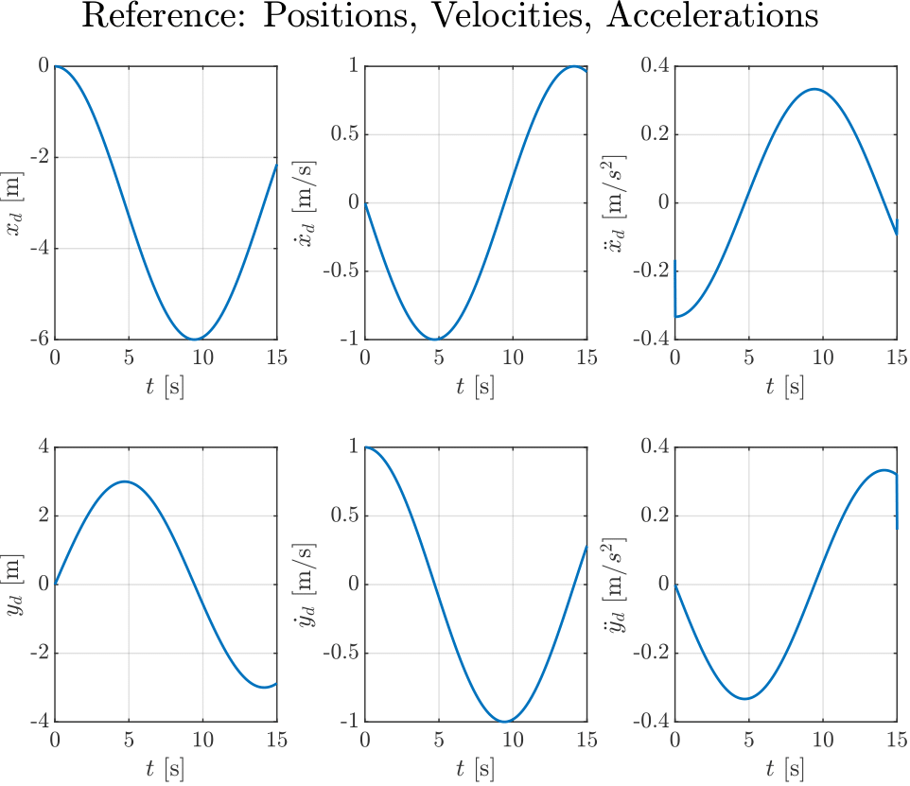
Path Generation: Circular Path
Equations

Slide 7
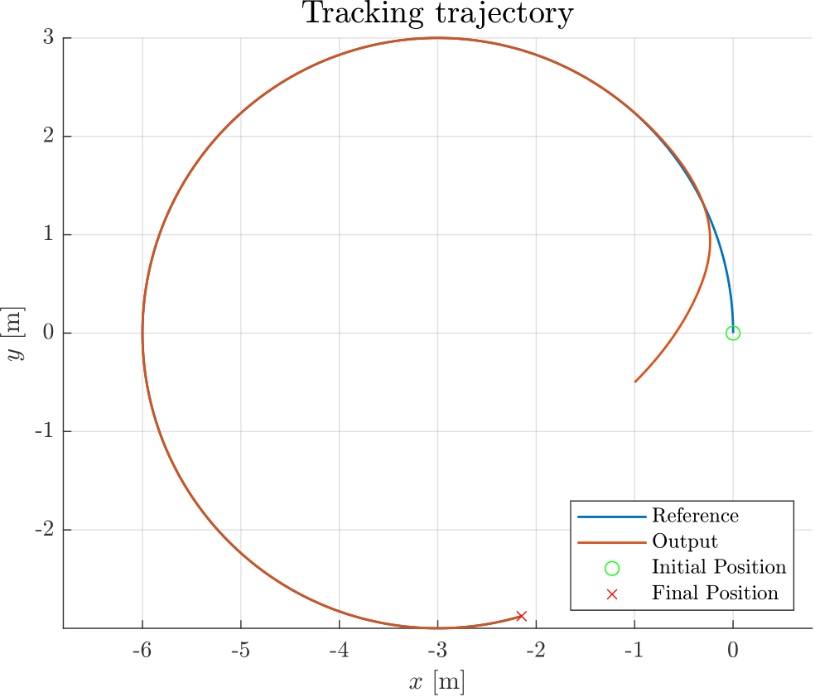
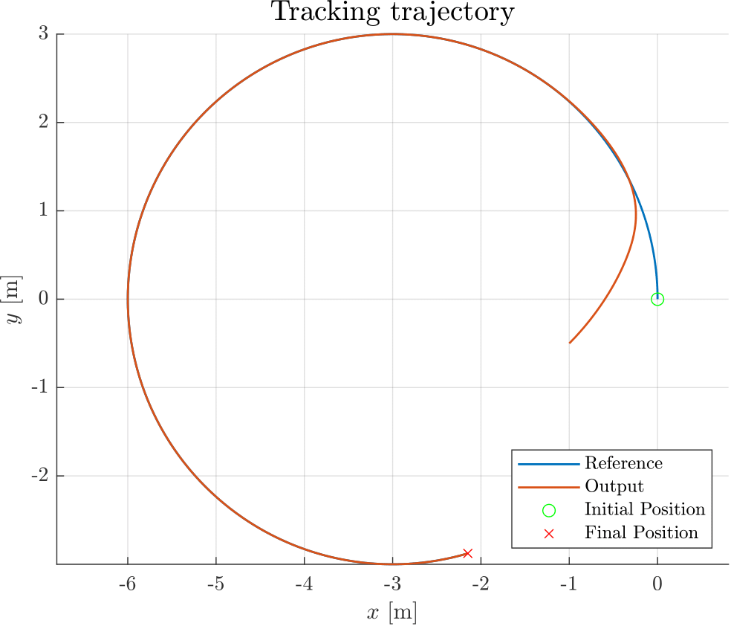
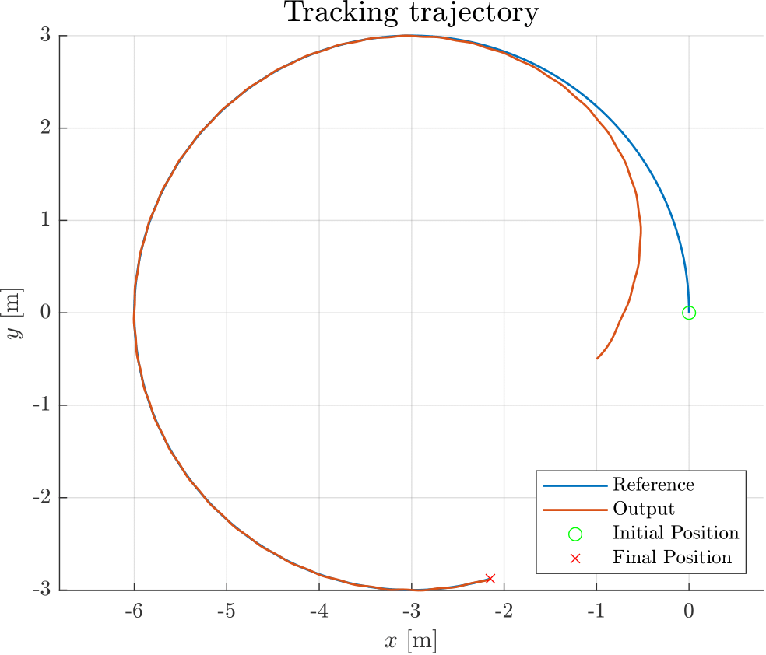
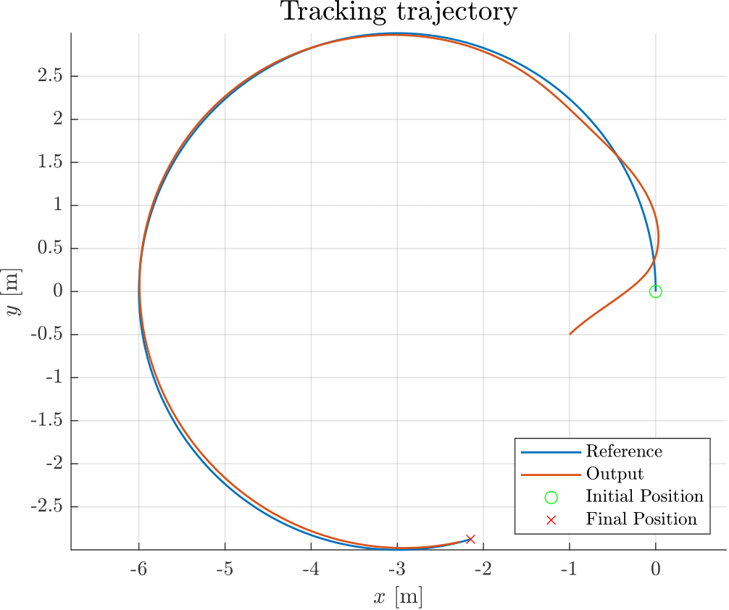
Tracking Problem: Common Approaches
State Feedback linear (a = 3, ζ = 0.5):
State Feedback non-linear (a = 3, ζ = 0.5):
Output Feedback (b = 0.75, k1 = 1, k2 = 1):
Z Feedback (Kp = [8 5], Kd = [0.8 1]):

Slide 8
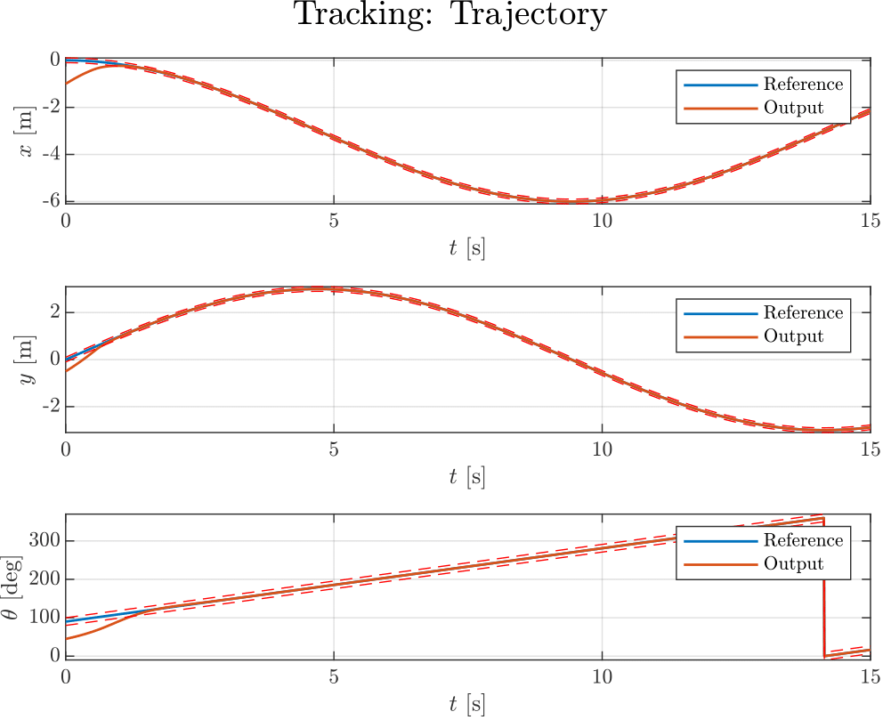

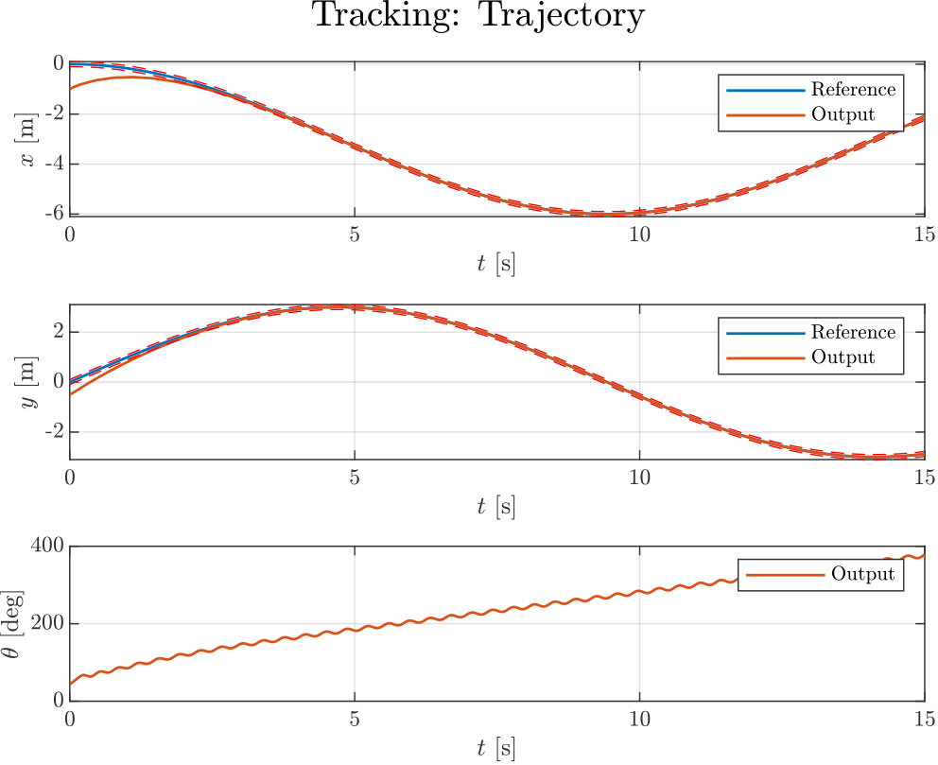
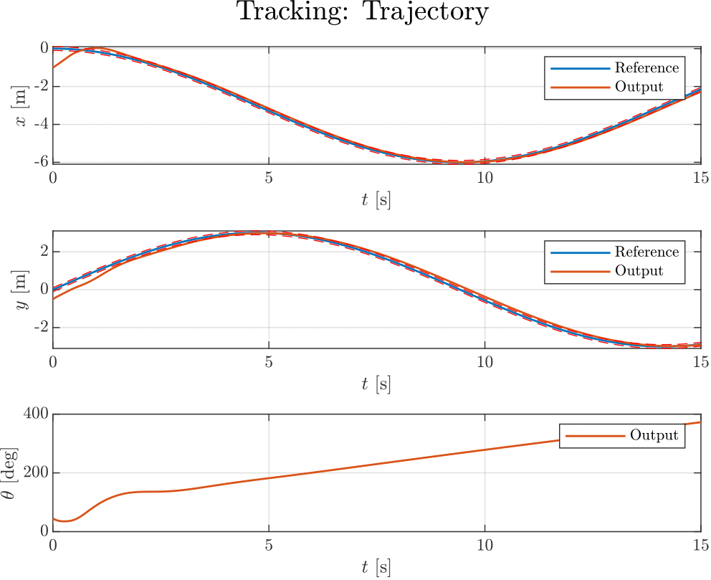
Tracking Problem: Common Approaches
State Feedback linear (a = 3, ζ = 0.5):
State Feedback non-linear (a = 3, ζ = 0.5):
Output Feedback (b = 0.75, k1 = 1, k2 = 1):
Z Feedback (Kp = [8 5], Kd = [0.8 1]):

Slide 9
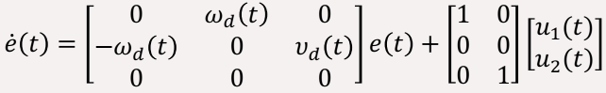
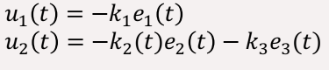
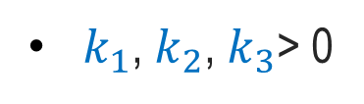
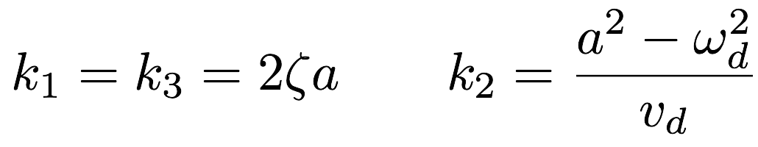
Tracking Controller: Linear State feedback
The linearized error dynamics
The following feedback control is designed
This is a time-varying linear system

Slide 10
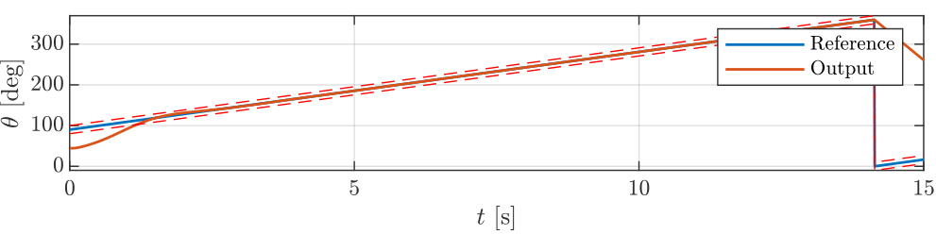
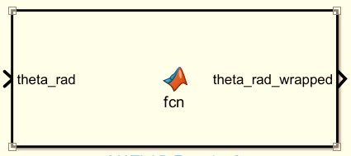

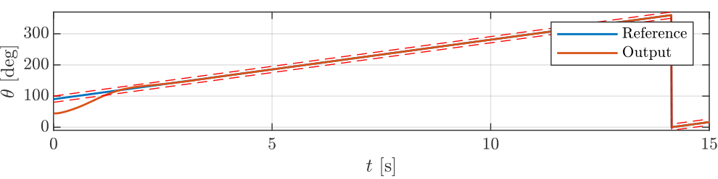
Tracking Problem: Problem encountered
Before State Feedback linear (a = 3, ζ = 0.5):
After State Feedback non-linear (a = 3, ζ = 0.5):

Slide 11
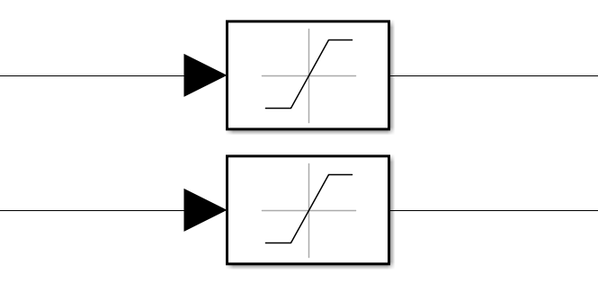
Saturation: actuator input commands
Saturation
v
w

Slide 12
Tracking: Performance Measurements
Numerical:
Dynamic:
RMSE
Custom Rise Time
Prescribed performance bounds

Slide 13
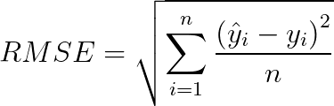
Numerical Performance Measures: Tracking
RMSE
Where,

Slide 14


Numerical Performance Measures: Tracking
Rise Time
Initially: used stepinfo MATLAB function
Problem
In our case not a response of a dynamical system
Custom Rise Time
Idea: use a fixed tolerance band
Solution
create add hoc MATLAB function for Rise Time

Slide 15
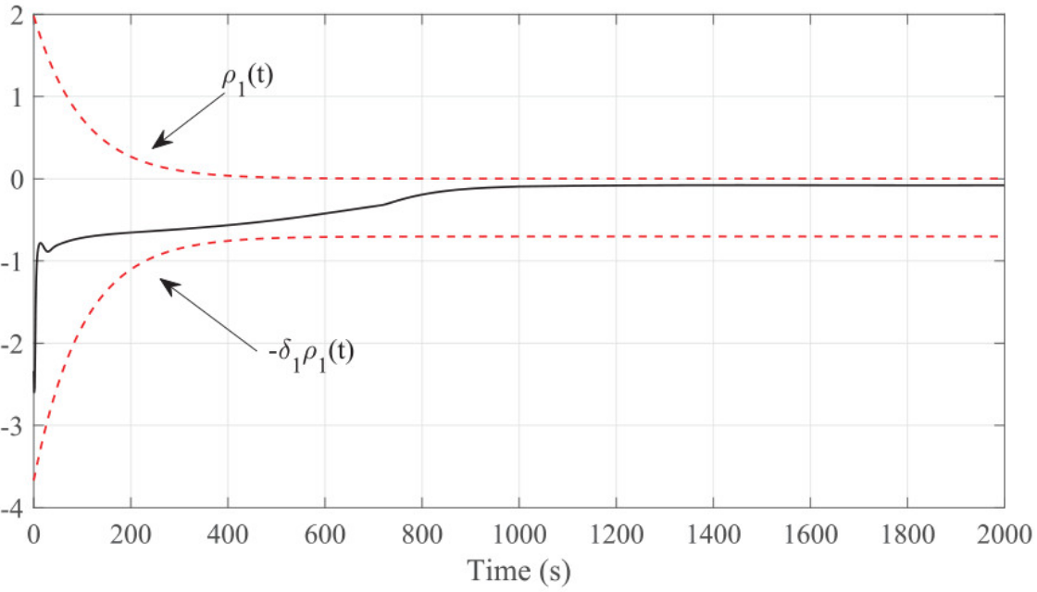
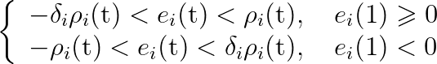
Prescribed Performance Bounds
Exponentially Decreasing Function
The boundary expressions for tracking errors are as follows
https://journals.sagepub.com/doi/full/10.1177/0142331220928887
https://thesis.unipd.it/bitstream/20.500.12608/17505/1/Zambelli_Martina_tesi_magistrale.pdf

Slide 16
Tracking Controllers: Qualitative Tuning
Saturation
Controller Tuning
Custom Rise Time
RMSE
Prescribed Bounds

Slide 17
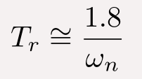
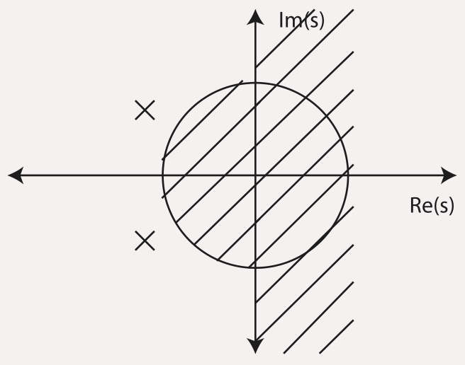
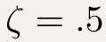
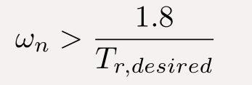
Qualitative Tracking Controller Tuning
Approximation: Considering the two dominant eigenvalues -> Second order system

Slide 18
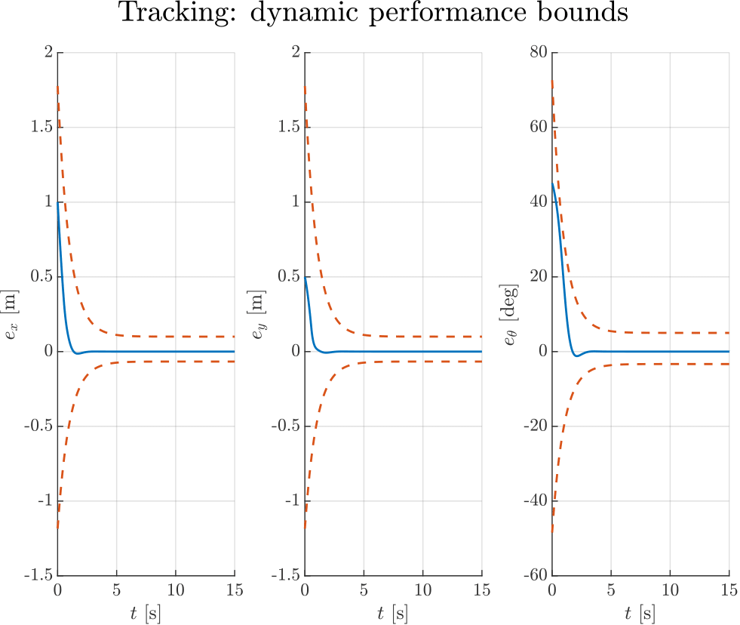
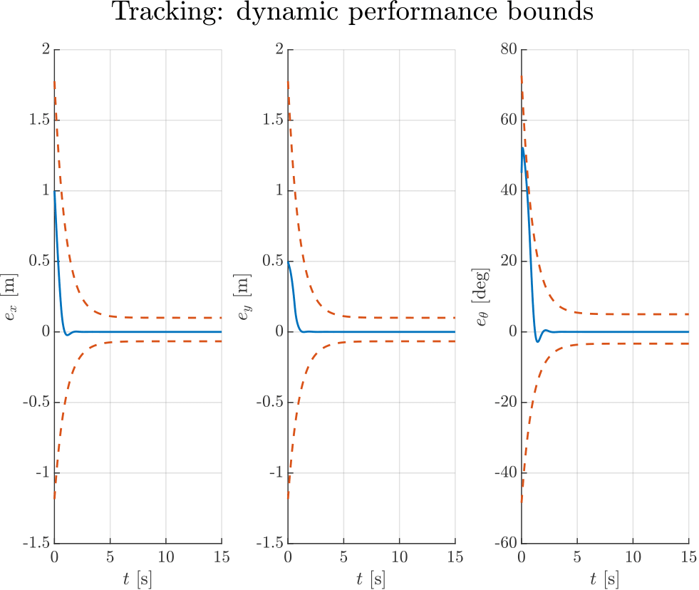
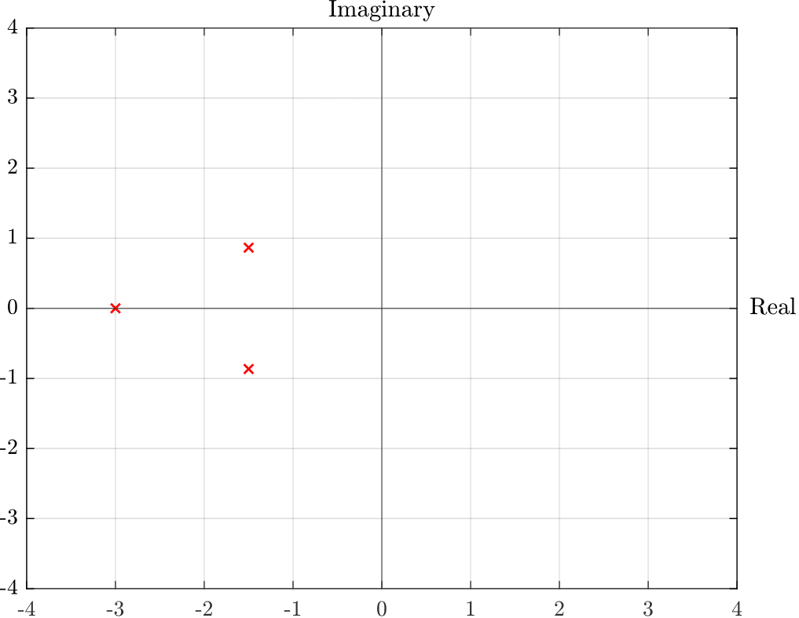
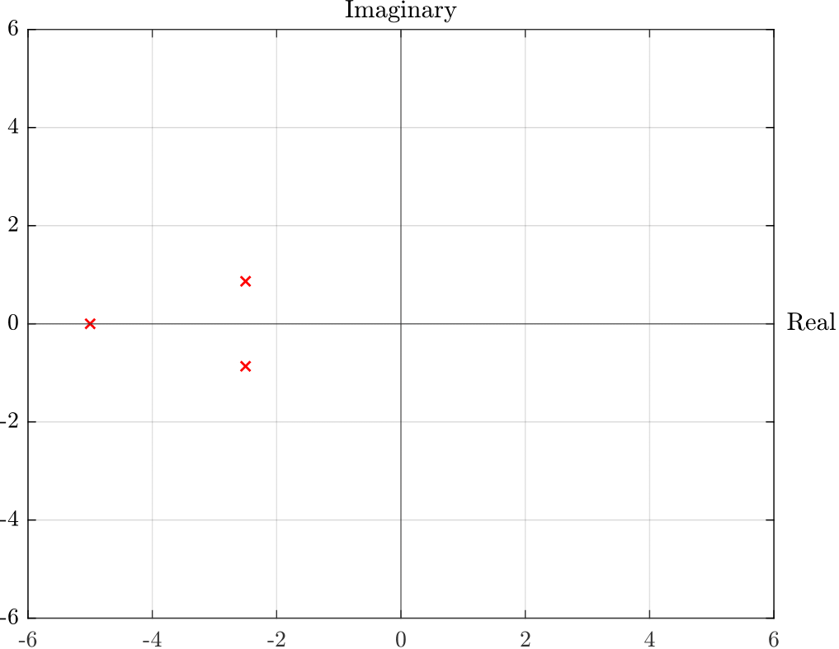
Dynamic Performance bounds
State Feedback linear (a = 3, ζ = 0.5):
State Feedback linear (a = 5, ζ = 0.5):

Slide 19
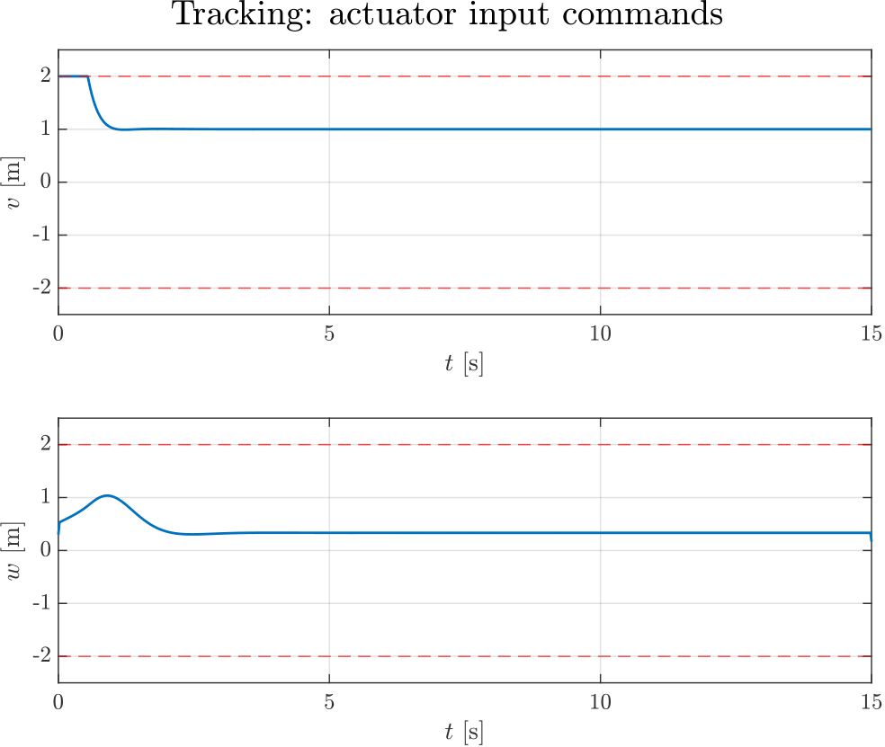
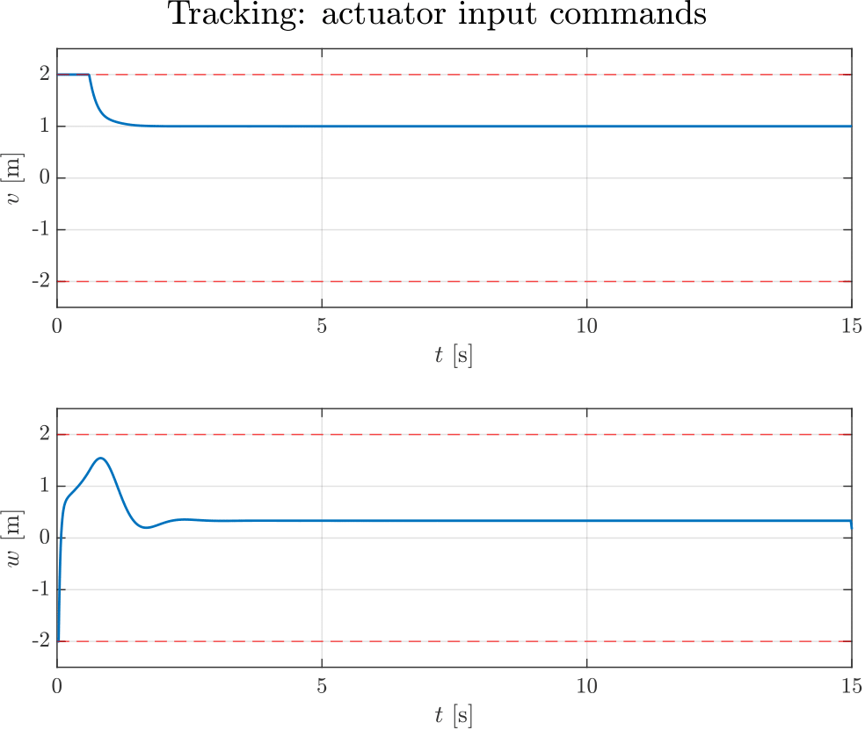
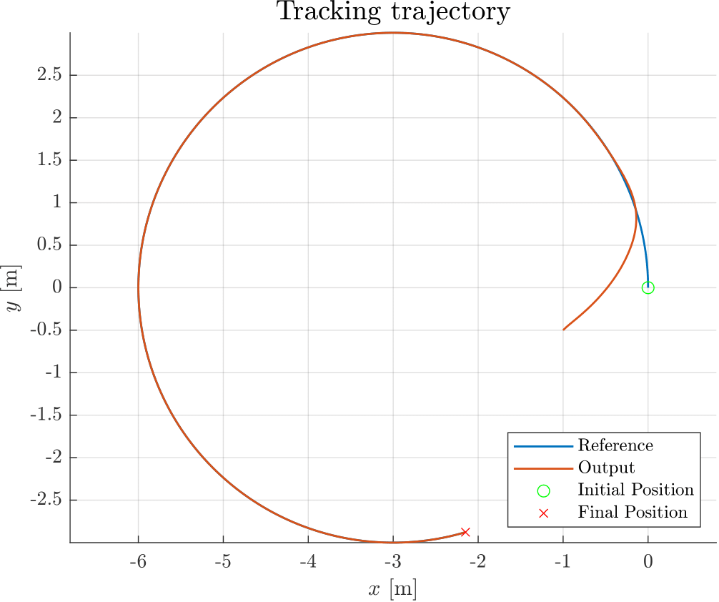
Saturation: actuator input commands
State Feedback linear (a = 3, ζ = 0.5):
State Feedback linear (a = 5, ζ = 0.5):

Slide 20

Summary
 | a = 3 , zeta = 0.5 | a = 5 , zeta = 0.5
Custom_RiseTime_XY | 0.84 | 0.74
Custom_RiseTime_Theta | 1.18 | 0.99
RMSE_x | 0.129 | 0.124
RMSE_y | 0.076 | 0.079
RMSE_theta | 9.97 | 10.06
Trade Off

Slide 21
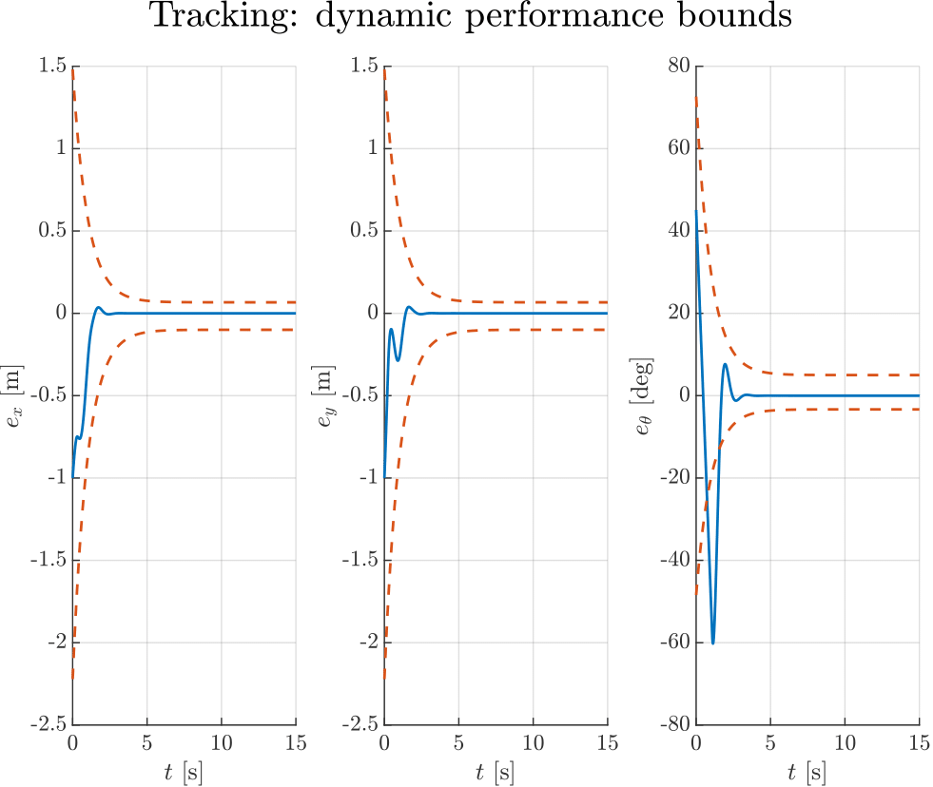
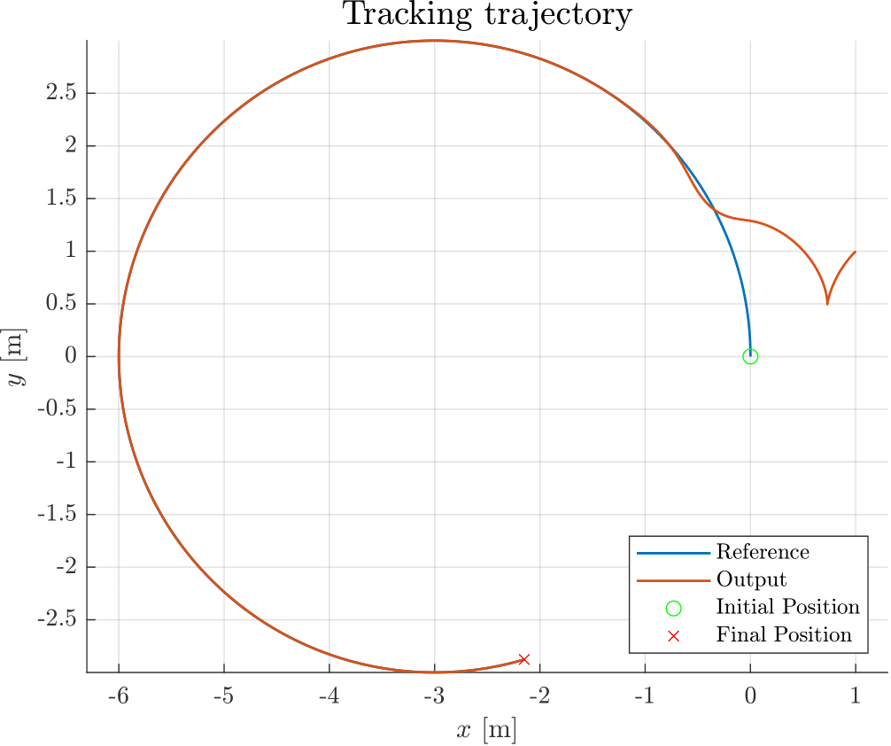
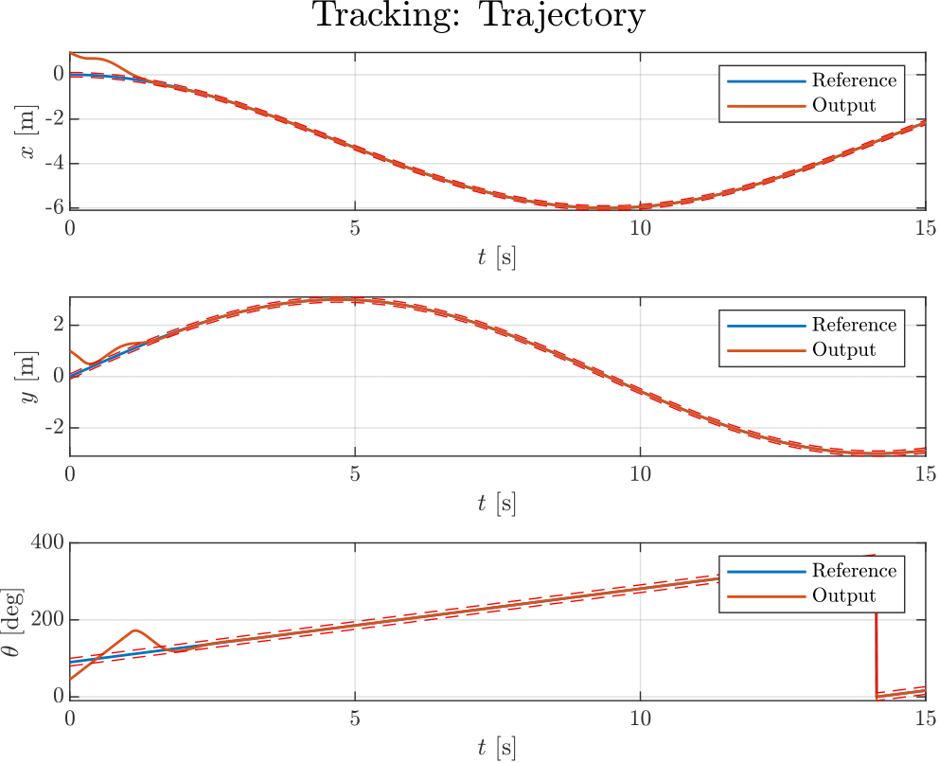
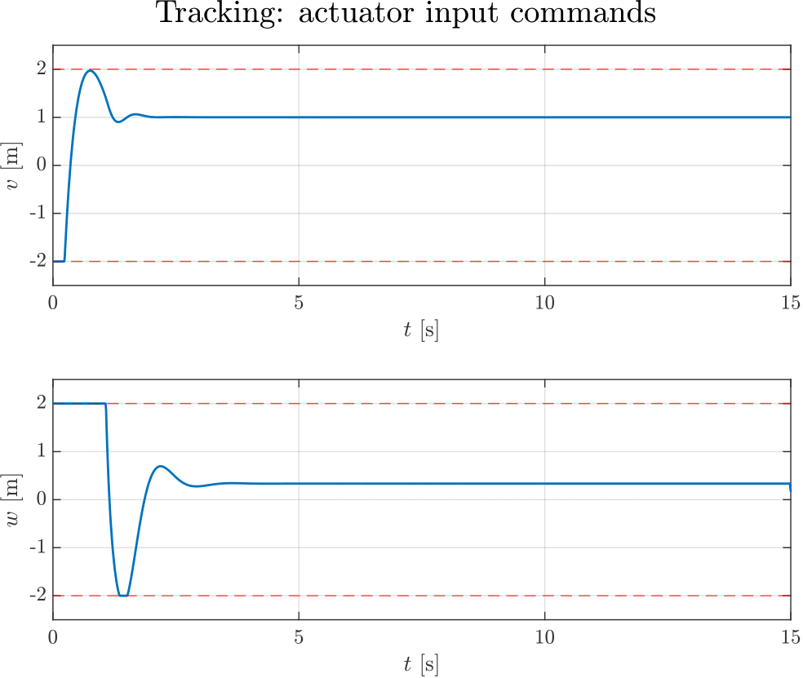
Dynamic Performance bounds: another IC
State Feedback linear (a = 5, ζ = 0.5):

Slide 22
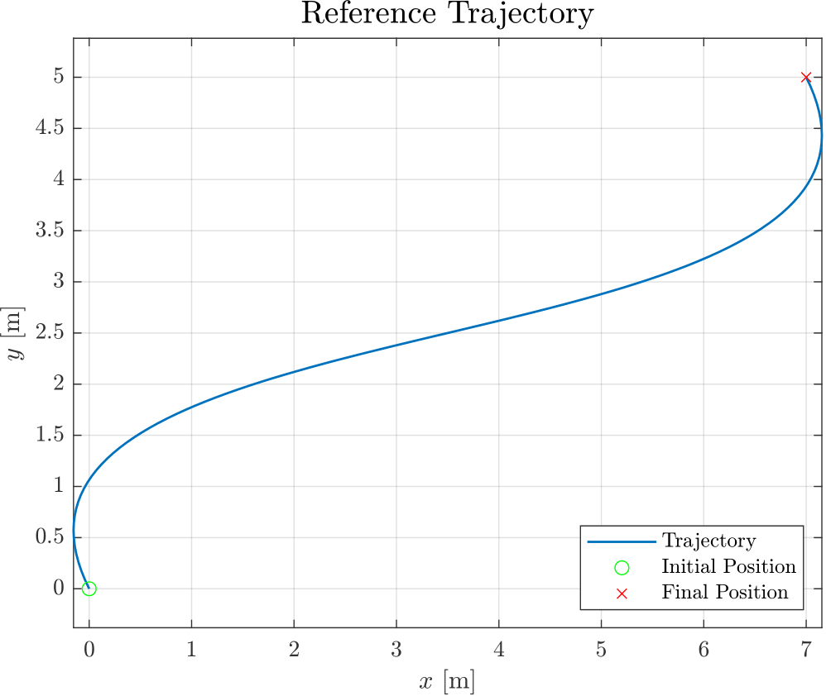
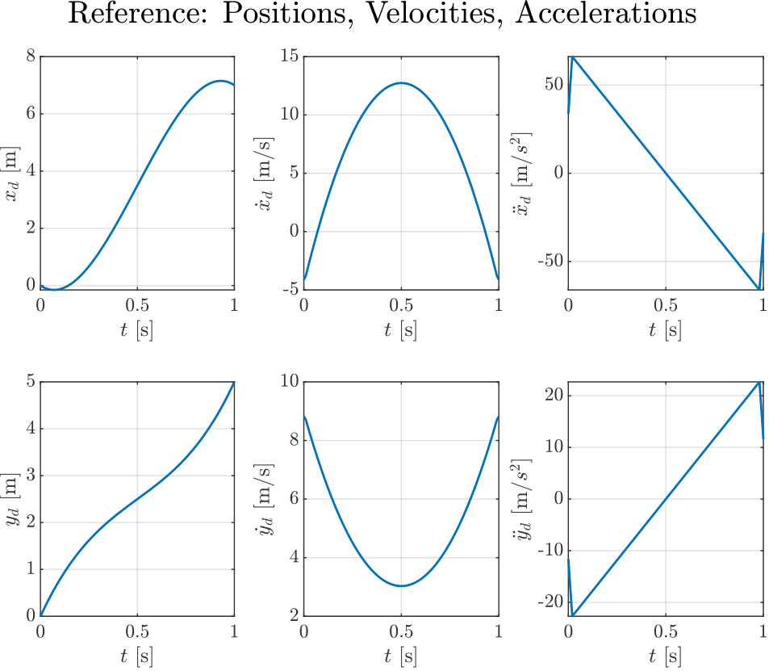
Path Generation: Cubic Polynomial
Equation

Slide 23
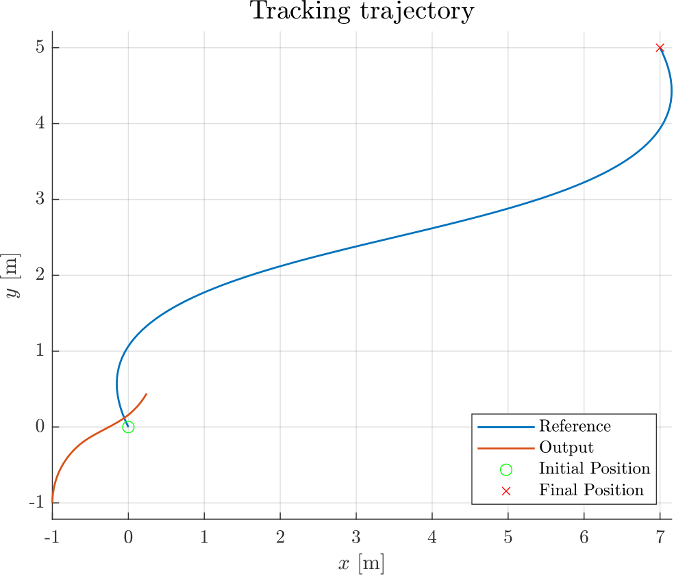
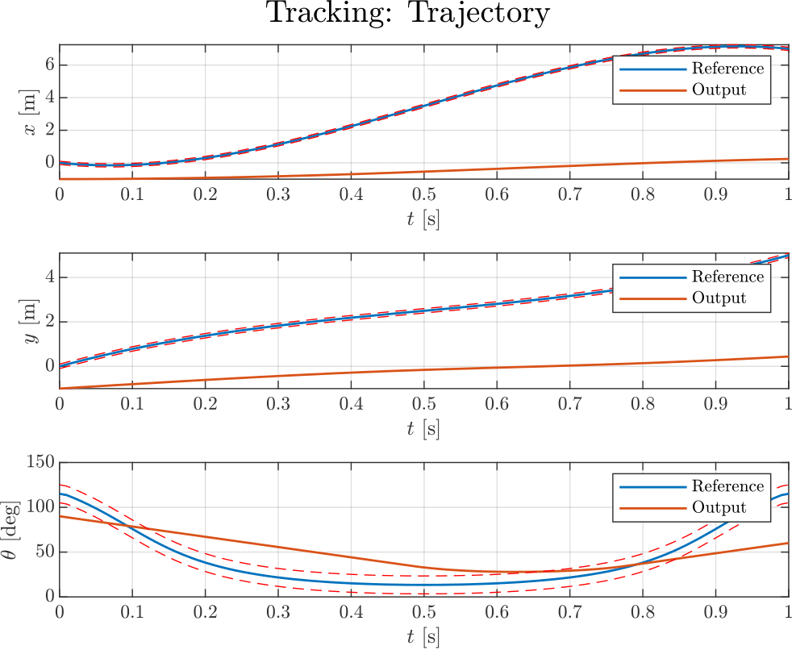
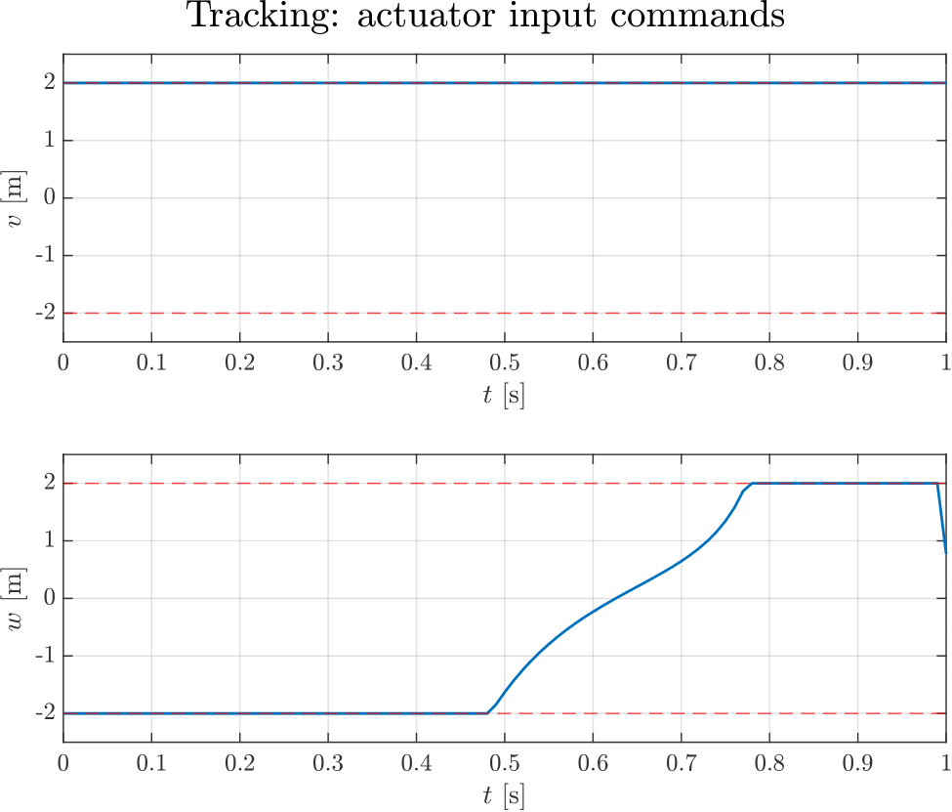
Cubic Polynomial: Problems

Slide 24
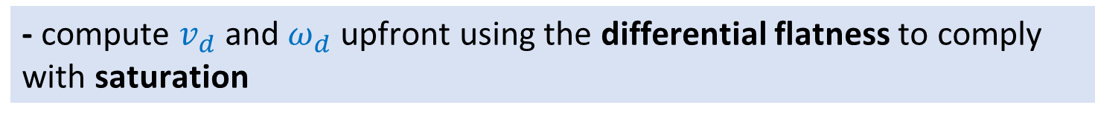
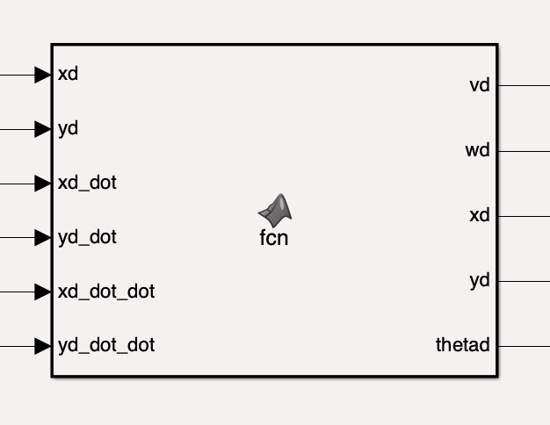
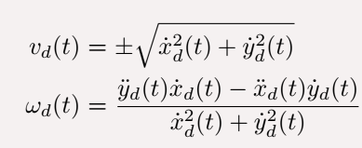
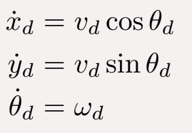
Dealing with Saturation: Offline Differential Flatness
Idea:
At the beginning:
Now:

Slide 25
Dealing with Saturations
Necessary Modifications:
Trajectory Generation
Trajectory already define in time
Trajectory defined in space
Uniform Scaling: on step size and trajectory duration
different timing law

Slide 26
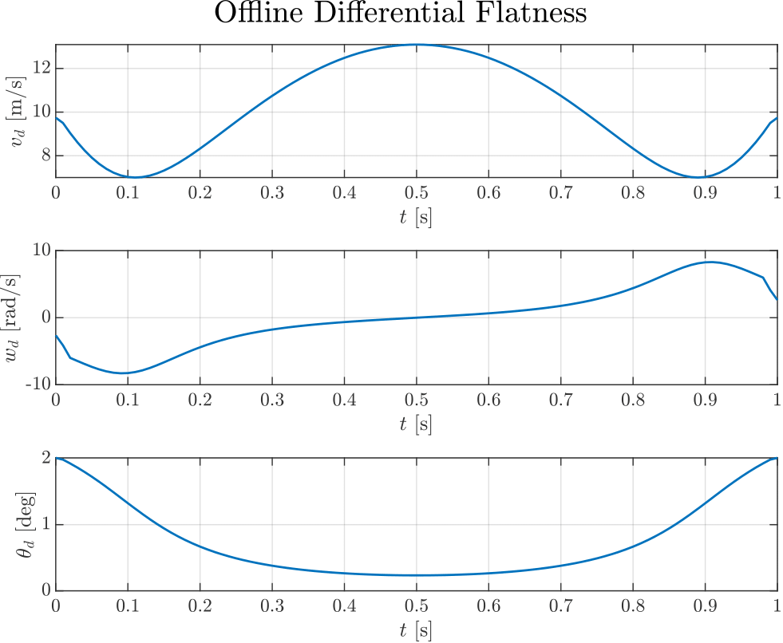

Saturations: After scaling

Slide 27




Cubic Polynomial: Solution

Slide 28



Switch between Tracking and Regulation

Slide 29



Regulation Problem
Goal

Slide 30


Regulations: Handle Different IC

Slide 31






Regulation Problem: Common Approaches
Cartesian Regulation
K =[1 ,1]
Posture Regulation without Singularity : K =[3,3 ,1]
Posture Regulation with Singularity : K =[3,3 ,1]

Slide 32




Regulation Problem: Common Approaches
Posture Regulation without Singularity K =[2,2 ,1]
Posture Regulation with Singularity K =[2,2 ,1]

Slide 33








Regulation Controller: Posture Control
We can design the following feedback controller
This controller makes the system converging to
The closed-loop system is

Slide 34
Numerical Performance Measures: Regulation
Settling Time
Initially: used stepinfo MATLAB function
Problem
In our case not a response of a dynamical system
Custom Settling Time
Idea: use a fixed tolerance band
Solution
create add hoc MATLAB function for Settling Time

Slide 35
Regulation Controllers: Fine Tuning
Saturation
Controller Tuning
Settling Time
Prescribed Bounds
The gains of the controllers are chosen according to the system requirements

Slide 36
Circular trajectory + Posture control
 | K = [1, 1, 1] | K = [1, 1, 3] | K = [3, 3, 1]
Settling Time X | 17.71 | 20.76 | 14.60
Settling Time Y | 16.09 | 19.17 | 14.13
Settling Time Theta | 19.94 | 22.18 | 22.11
Trade Off

Slide 37



Posture Regulation: q=[0,0,0]
K =[3,3,1]

Slide 38



Regulations: Handle Different Final Pose
Transformation of variables:

Slide 39




Pose Regulation: Different Final Pose q=[1,1,90]
K =[3,3,1]

Slide 40

Regulations: Handling Singularity of (𝜔)
Numerical

Slide 41

Simulink Solver Configurations
Tracking
“mandatory”
Fixed Step Size
Regulation
Fixed Step Size
“elective”

Slide 42

Cubic Polynomial trajectory + Posture control

Slide 43
Summary
Tracking
Path generation and its problems
Common Approaches and their Performance Measures
Tuning to satisfy performance constraints
Pros and cons of using Linear State Controller
Regulation
Common Approaches and their Performance Measures
Tuning to satisfy performance constraints
Pros and cons of using Posture Regulation

Slide 44


Simulink Schemes
State Feedback Linear
Posture Regulation With Singularity

Slide 45


Questions

